Slide 1
COMP1860 Building our Digital World: Computer Systems & Architecture
S1.W3.L1: Non-numeric Data Representations
Dr James Dyer

Slide 2
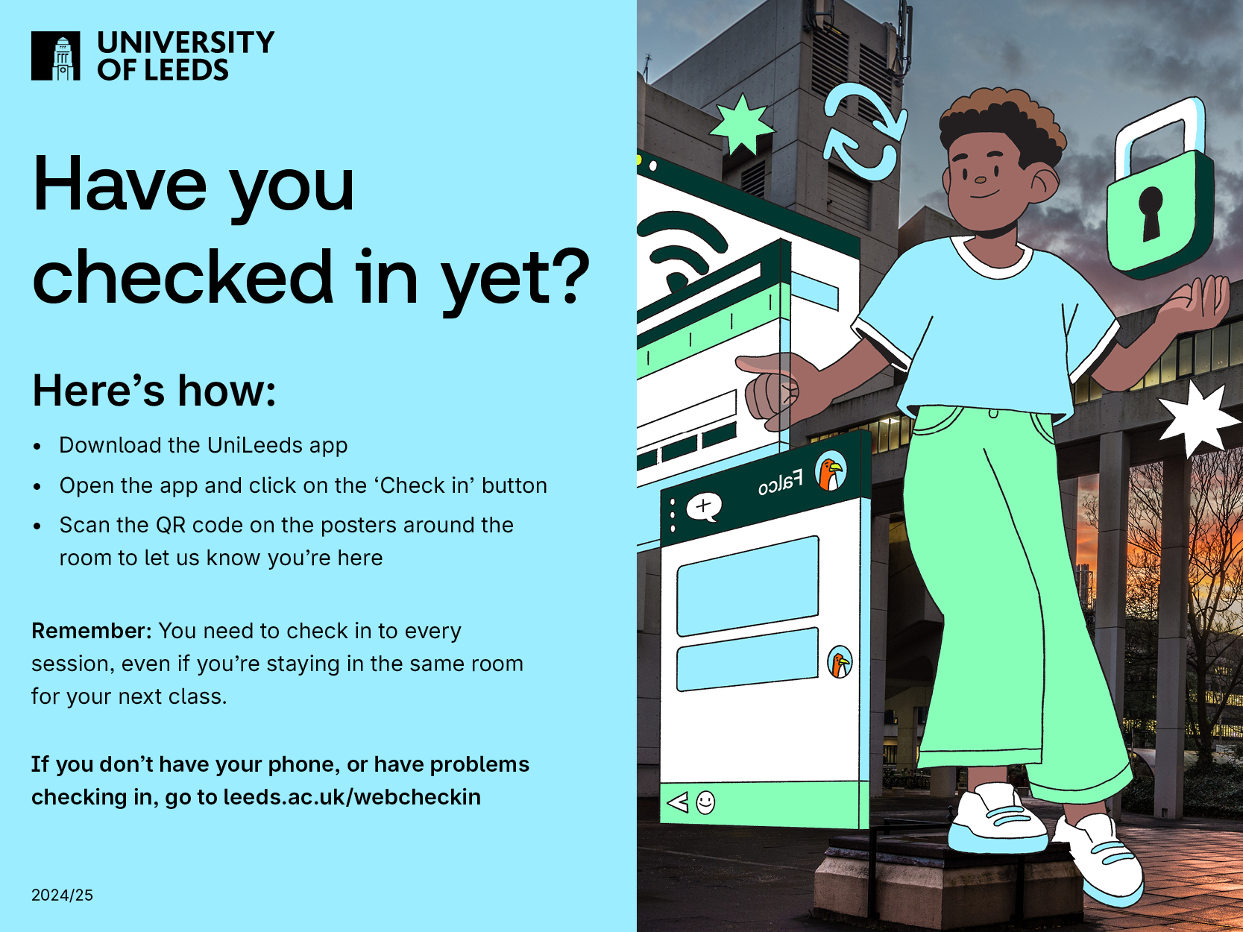

Slide 3
Learning Outcomes
Explain the bit-level representations of non-numeric data.

Slide 4
Overview
Text representations
Other non-numeric data & data structure representations
Image representations

Slide 5
Text Representation

Slide 6
Text Representation
Computers operate on binary values not text data
  All calculations done on bits and bytes
How then do computers interpret and process text data?
They represent characters as strings of bits

Slide 7
Character Sets
A character set is a list of characters
  E.g. Alphabetic letters
Each character in the set is enumerated
  E.g. 0=A, 1=B, 2=C, etc.
We can then identify characters as numbers
  Can convert numbers to binary
  This is called a character set encoding

Slide 8
ASCII (American Standard Code for Information Interchange)
The most ubiquitous character set & encoding is ASCII
ASCII set covers 128 different characters
  Upper- and lower-case Latin alphabet characters
  Punctuation symbols
  Non-printing characters such as end of line (EOL), line feed (LF), and carriage return (CR)
Each character is assigned a number from 0 to 127, the ordinal value.
A computer stores this as 8 bits (1 byte). The first bit is always zero.
ASCII allows a byte to be interpreted as a character.

Slide 9
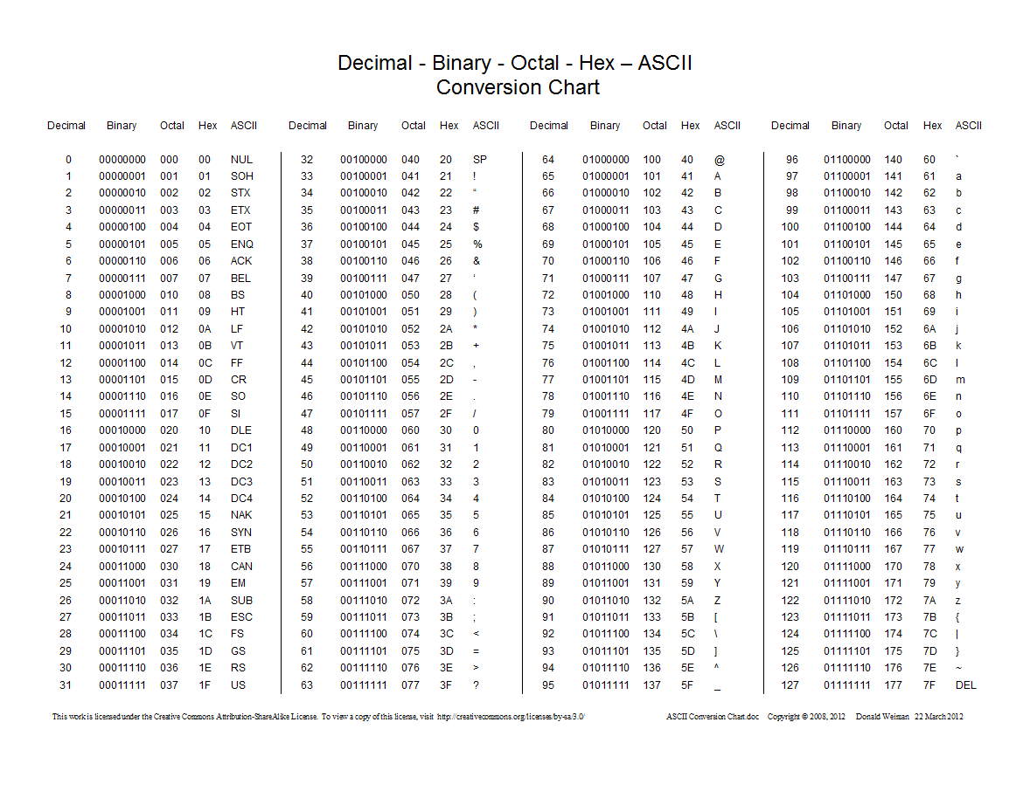

Slide 10
Character Set Problems
ASCII only covers 128 characters
Problem:
  Doesn’t cover
    Accented Latin characters
    Greek, Cyrillic, Chinese, Arabic and other alphabets
Solution:
  Use a different character set for Greek characters, Chinese characters, etc.
  This was the solution used in the past
Problem:
  Data in foreign character sets not interpreted correctly from bytes unless the OS is aware of character encoding.

Slide 11
Unicode
Unicode was devised as a consistent way to encode most characters used in worldwide languages
Unicode character set defines 154,998 characters
  Modern and historic alphabets
  Symbols
  Emojis
  Control and formatting characters
  Enumerations are called code points
Implemented by character encodings
  UTF-8, UTF-16, UTF-32 and others
  UTF-8 is the dominant standard

Slide 12
UTF-8 (Unicode Transformation Format – 8 bit)
Uses 1 to 4 bytes to encode a character
Capable of encoding 1,112,064 different characters (far more than the Unicode character set)
Some bits in each byte are reserved like ASCII(每个字节中的一些位像ASCII一样保留)
The first 1 to 5 bits of the first byte determine if the character is 1, 2, 3, or 4 bytes long
1-byte UTF-8 characters are identical to ASCII(第一个字节的前1到5位确定字符的长度是1、2、3还是4个字节, 1字节UTF-8字符与ASCII相同)
First code point | Last code point | Byte 1 | Byte 2 | Byte 3 | Byte 4
U+0000 | U+007F | 0xxxxxxx
U+0080 | U+07FF | 110xxxxx | 10xxxxxx
U+0800 | U+FFFF | 1110xxxx | 10xxxxxx | 10xxxxxx
U+10000 | U+10FFFF | 11110xxx | 10xxxxxx | 10xxxxxx | 10xxxxxx

Slide 13
Sample UTF-8 Character Encodings
Character | Code Point | Binary UTF-8 Encoding | Hex UTF-8 Encoding
$ | U+0024 | 00100100 | 24
£ | U+00A3 | 11000010 10100011 | C2 A3
ह | U+0939 | 11100000 10100100 10111001 | E0 A4 B9
€ | U+20AC | 11100010 10000010 10101100 | E2 82 AC
한 | U+D55C | 11101101 10010101 10011100 | ED 95 9C
𐍈 | U+10348 | 11110000 10010000 10001101 10001000 | F0 90 8D 88

Slide 14
How to convert code point to UTF-8 encoding
Convert hex digits to binary string
Determine whether 1-, 2-, 3-, or 4-byte encoding based on code point
Insert binary string into x positions in encoding
  Pad with zeroes at front if more x’s than bit

Slide 15
Example: Grinning Face Emoji (😀)
The grinning face emoji has the Unicode code point: 1F600
Convert the 5 hex digits to binary
  0001 (1) 1111 (F) 0110 (6) 0000 (0) 0000 (0)
Determine number of bytes in encoding
  1F600 is larger than 10000, so this is a 4-byte encoding
  11110xxx 10xxxxxx 10xxxxxx 10xxxxxx
Insert bits in place of x’s
  11110000 10011111 10011000 10000000 (added zero at front to make 21-bits)
Converting this to hex gives F0 9F 98 80 (UTF-8 hex encoding)

Slide 16
Exercise
Calculate the binary encodings of the following Unicode code points:
U+007E (tilde: ~)
U+00A9 (copyright symbol: ©)
U+16AB (Aesc rune: ᚫ)
U+1F911 (money mouth face emoji 🤑)

Slide 17
Other non-numeric data & data structure representations

Slide 18
Non-numeric data
Non-numeric data types
Data Structures
Booleans
Date/Times
Text Strings
Arrays
Records

Slide 19
Booleans
Boolean data has two possible values: True (1) or False (0)
Ideally represent at 1-bit
In practice, stored in larger value
  In C, a signed 32-bit integer where 0 is false, any other value is true
  In Java, a single 16-bit Unicode character
  In Python, stored as Python integer

Slide 20
Date/Time
Unix epoch time
  number of seconds since Jan 1, 1970
  Typically implemented as positive 32-bit signed integer
  Year 2038 problem
    Date will overflow after 19 Jan 2038.
    Need to convert to 64- or 128-bit value.
Windows epoch time
  Number of 100ns intervals since Jan 1, 1601
  Implemented as unsigned 64-bit integer

Slide 21
Date/Time: Network Time Protocol
Network Time Protocol
  Number of seconds since Jan 1, 1900
  Implemented as fixed-point fraction
    32-bits for seconds, 32-bits for fractional part
    Overflow on Feb 7, 2036
  NTPv4 implements as 128-bit fixed-point fraction
    64-bits for seconds, 64-bits for fractional part

Slide 22
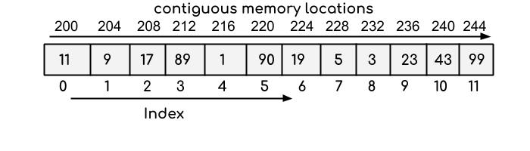
Arrays
An array is a set of values of the same type (integer, floating-point, text characters, etc.) stored as a contiguous sequence.
Each element of the sequence is referred to by a numerical index
Like a Python list

Slide 23
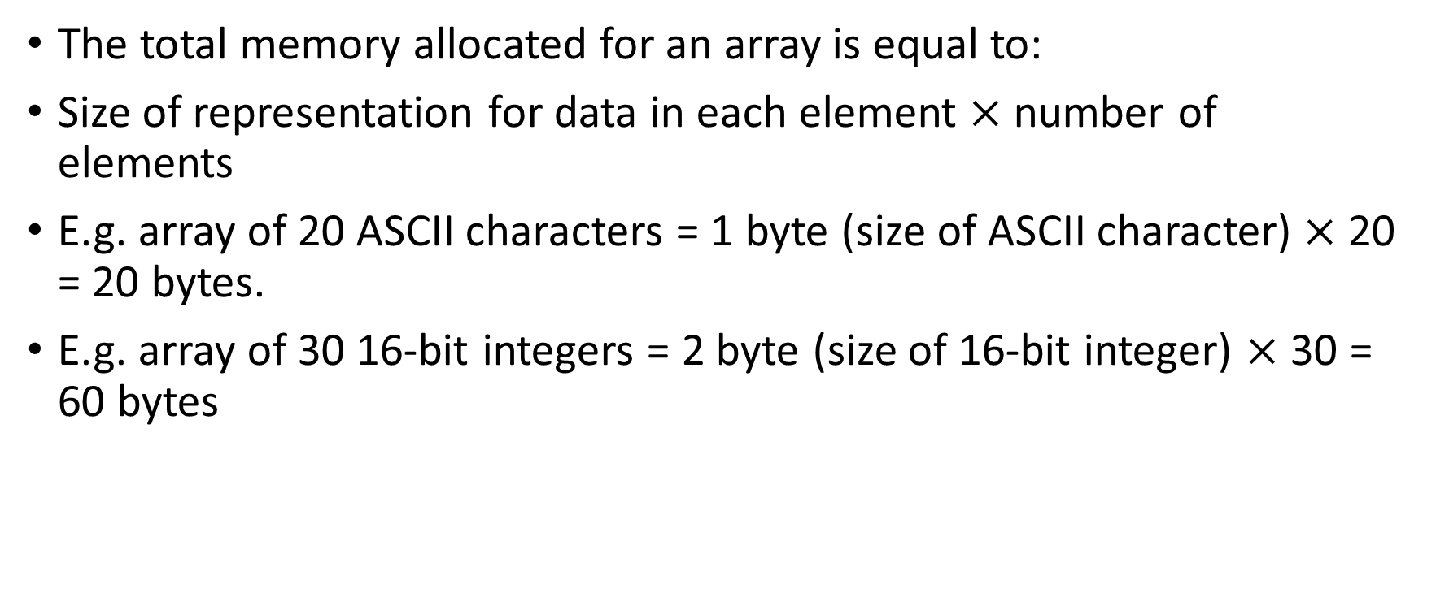
Size of an array in memory
The total memory allocated for an array is equal to:
Size of representation for data in each element $×$ number of elements
E.g. array of 20 ASCII characters = 1 byte (size of ASCII character) $×$ 20 = 20 bytes.
E.g. array of 30 16-bit integers = 2 byte (size of 16-bit integer) $×$ 30 = 60 bytes

Slide 24
Strings
You have encountered strings in Python
A string is composed of sequence of text characters.
How might this be represented in memory?

Slide 25
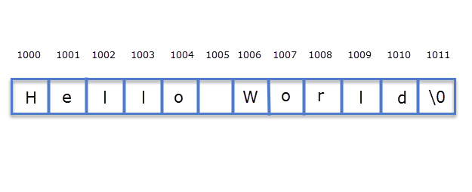
String as character arrays
Strings can be represented as an array of characters
  Each individual character is represented by character encoding, e.g. ASCII or UTF-8
For example, “Hello World”

Slide 26
How do programming languages represent strings?
C strings are arrays of ASCII characters terminated with a null character (size is number of characters in string + 1).
Java strings are internally stored as arrays of 16-bit Unicode characters (representing Unicode code points U+0000 to U+FFFF).
Python 3.3+ strings are internally stored as arrays of Unicode characters (1, 2, or 4 bytes used per character, Unicode code points U+0000 to U+007F (ASCII) are stored in one byte).

Slide 27
Records
A record is a set of related data collected under a single name
For example, an address may consist of
  House Name/Number
  Street Name
  Town/City
  County
  Post Code
  Country
Each of these related data items is called a field and together they form a record.
  E.g. (University of Leeds, Woodhouse Lane, Leeds, West Yorkshire, LS2 9JT, UK) is an example of an address record.

Slide 28
Records
Note that each field can be a different type of data
  Each field can be one of numeric, text data, datetime, etc.
How would this be stored in memory?
Most programming languages would store this data contiguously
  Each field allocated memory to store it
  Each field stored consecutively in memory
  Memory allocated in field order
Examples:
  C structs
  Objects in object-oriented programming (Python, Java)

Slide 29
Example Record
type element = record{
name : char[2]; //array of 2 characters
atomic_number : integer;
atomic_weight : double;
metallic : Boolean //whether metallic or not
};
Total Memory size =
sizeof(char) *2 + sizeof(integer) + sizeof(double) + sizeof(Boolean)

Slide 30
Word Aligned Storage
Ideally, we would like the storage in memory to be:
  Sum of the sizes of each of the fields
  E.g., Element record is 15 bytes (assuming Boolean is 1-byte)
However, many programming languages word align the fields
  Makes it easier for system to locate start and end of field
  Pads field to word length (or some neat division)
  E.g., char[3] – 3-character array would be padded with one extra byte to make 4 bytes on a 32-bit word machine

Slide 31
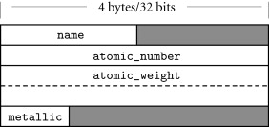
Example: Word Alignment
type element = record{
name : char[2];
atomic_number : integer;
atomic_weight : double;
metallic : Boolean
};
Likely layout in memory for objects of type element on a 32-bit machine. Areas in grey are padding to align data items to word size. (Source: Scott, M., Programming Language Pragmatics (Third Edition)
2009, Pages 289-381)

Slide 32
Word alignment in programming languages
In the C/C++ languages (for a 64-bit machine):
A char (one byte) will be 1-byte aligned.
A short (two bytes) will be 2-byte aligned.
An int (four bytes) will be 4-byte aligned.
A long (8 bytes) will be 8-byte aligned.
A float (four bytes) will be 4-byte aligned.
A double (eight bytes) will be 8-byte aligned.

Slide 33
Exercise
Calculate the memory size in bytes for the following data items:
  An array of 20 integers in C (int)
  The string “Hello, World!” in the C language
  The internal representation of the string “Hello, World!” in the Java language
  A record with the following field types in order (char, short, float)
    Give 64-bit word aligned length

Slide 34
Image Representations

Slide 35
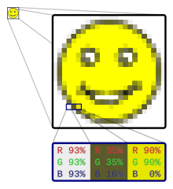
Raster Images
Most digital image formats are raster images (aka bitmaps or pixel maps)
  Image is represented as rectangular grid
  Each grid square is a pixel
  Pixel has a colour
    Colour encoded as bit sequence
  Whole image represented as sequence of pixels
Grid format can be treated as matrix
  Use matrix transformations to flip, scale, etc.

Slide 36

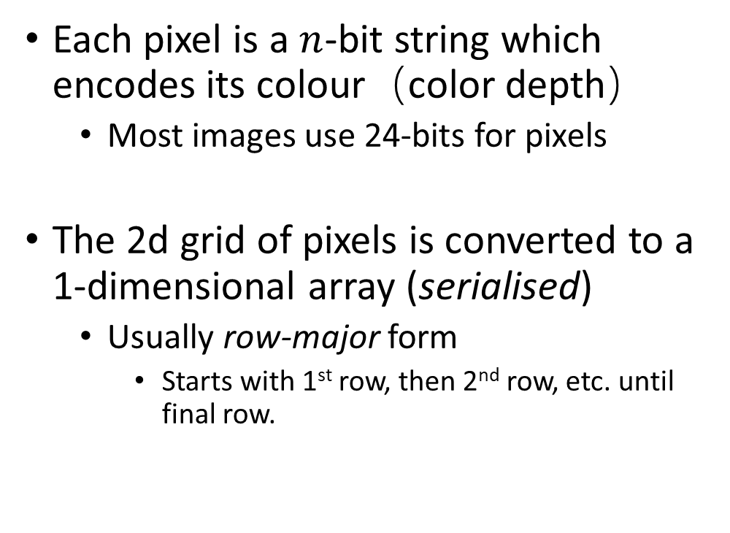
Raster image format
0 | 1 | 1 | 0 | 1 | 1
1 | 0 | 1 | 1 | 0 | 1
0 | 1 | 1 | 0 | 0 | 0
1 | 1 | 0 | 1 | 1 | 1
0 | 0 | 0 | 1 | 1 | 0
1 | 0 | 1 | 1 | 1 | 0
Each pixel is a $n$-bit string which encodes its colour（color depth）
  Most images use 24-bits for pixels
The 2d grid of pixels is converted to a 1-dimensional array (serialised)
  Usually row-major form
    Starts with 1st row, then 2nd row, etc. until final row.
6$×$6 grid of 1-bit pixels
0 1 1 0 1 1 1 0 1 1 0 1 0 1 1 0 0 0 1 1 0 1 1 1 0 0 0 1 1 0 1 0 1 1 1 0

Slide 37
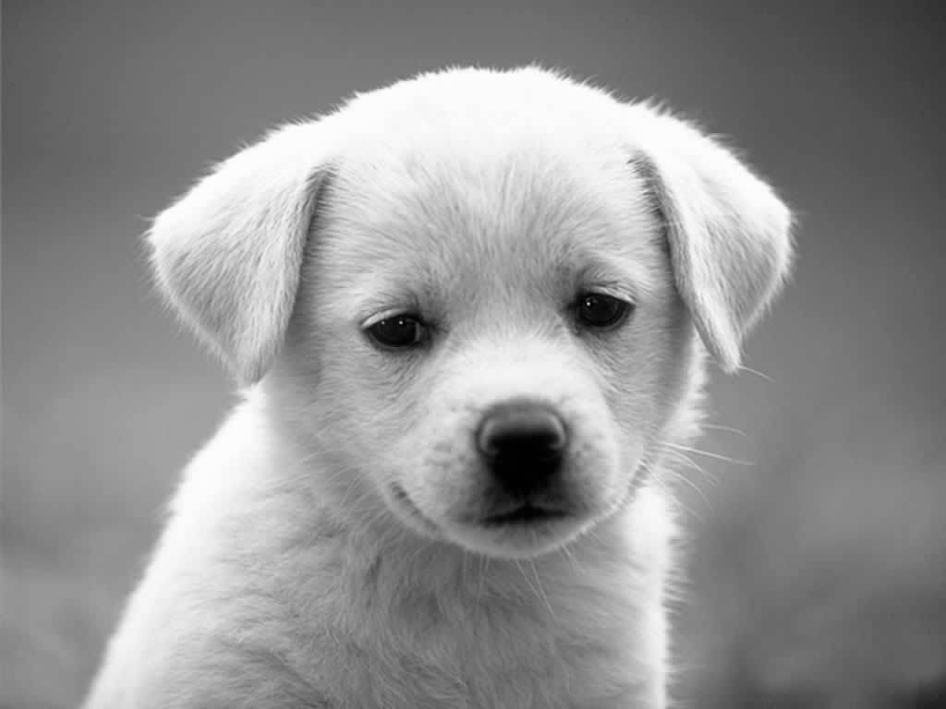
Portable Greymap (PGM) Images
PGM is a simple image file format which is text based
Supports greyscale images only
Each pixel encoded as a value from 0 (white) to MAX (black)
MAX ≤ 65536
Values between 0 and MAX are shades of grey
1-bit colour (black or white) is called Portable Bitmap (pbm)

Slide 38

NetPBM Example
PBM file:
P1 # magic number (PBM in ASCII format)
8 8 #(dimensions)
#pixel map
0 0 1 1 1 1 0 0
0 1 0 0 0 0 1 0
1 0 1 0 0 1 0 1
1 0 0 0 0 0 0 1
1 0 1 0 0 1 0 1
1 0 0 1 1 0 0 1
0 1 0 0 0 0 1 0
0 0 1 1 1 1 0 0
8$×8$ grid of 1-bit pixels

Slide 39
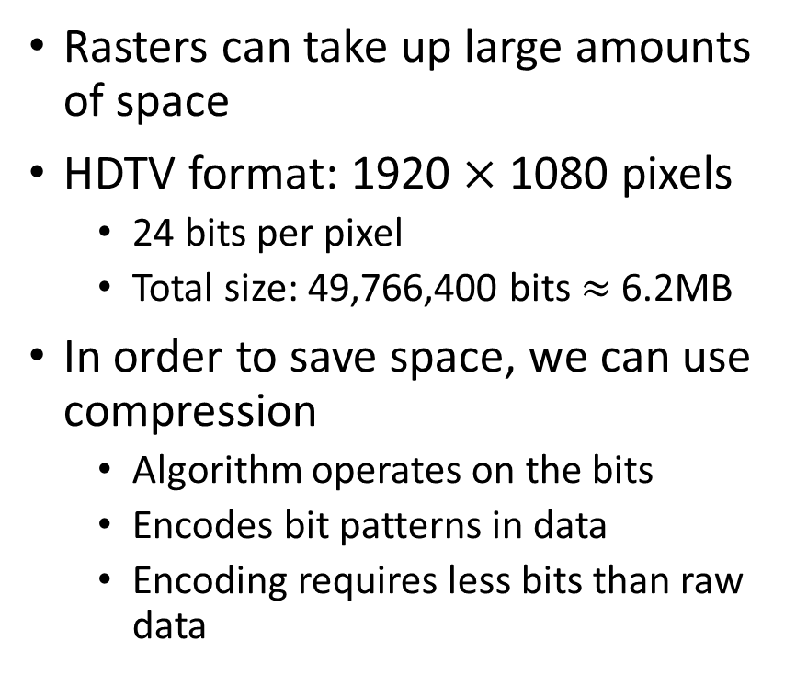
Image Formats and Compression
Rasters can take up large amounts of space
HDTV format: 1920 $×$ 1080 pixels
  24 bits per pixel
  Total size: 49,766,400 bits $≈$ 6.2MB
In order to save space, we can use compression
  Algorithm operates on the bits
  Encodes bit patterns in data
  Encoding requires less bits than raw data
Two types of compression:
  Lossless（无损压缩）
    Decompresses exactly
    E.g., TIFF (Tag Image File Format)
    GIF (Graphics Interchange Format)
    PNG (Portable Network Graphics)
  Lossy（有损压缩）
    Some data sacrificed to make smaller
    E.g. JPEG (Joint Photographic Experts Group)

Slide 40
Pixel Colour Depth
Each pixel is a coloured square
Encode each colour as a set of bits
How many bits used gives greater range of different colours: colour depth

Slide 41
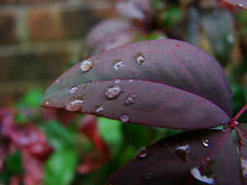

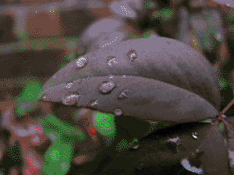
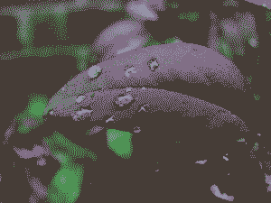
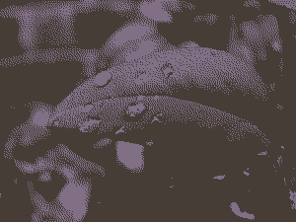
Colour Depth
24-bit, 16.7 million colours
8-bit, 256 colours
4-bit, 16 colours
2-bit, 4 colours
1-bit, 2 colours

Slide 42
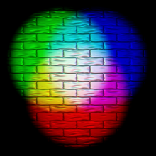
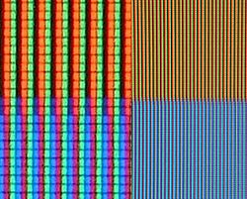
RGB Colour Models
Colour is composed of red, blue and green components
Bits represent how much of each colour is included
Expressed as a triplet of values(三元组)
  If all values zero, then black
  If all values maximum, then white
E.g. 24-bit RGB colour uses 8-bits for each colour
  256 levels of saturation for each colour – none to maximum
Additive colour model
  Each component adds to final colour
Additive colour mixing
Closeup of red, green and blue subpixels on an LCD display

Slide 43
RGB Numeric Representations
Given in hexadecimal format
  000000 is black
  FF0000 is red
  00FF00 is green
  0000FF is blue
  FFFFFF is white
Examples
  C55A11 is this colour
  92D050 is this colour

Slide 44

CMYK Colour Model
Colour is composed of cyan, magenta and yellow
  Complementary light colours
  Cyan is green & blue (no red)
  Magenta is red & blue (no green)
  Yellow is red & green (no blue)
Combining CMY components subtracts light colours(减少浅色)
  Magenta plus Yellow gives Red (only light colour in common)
Hence, called subtractive colour model
Typically used in printers
  Adds black ink (K) to provide darker colours in combination with CMY inks
Similarly to RGB colour can be expressed as tuple of C, M, Y, and K values
Pairwise combinations are red, green, and blue. Combining all three gives an imperfect black colour.

Slide 45
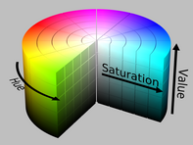
HSV Colour Model
RGB model represents colour as point using Cartesian coordinates (R, G, B axes)
HSV represents colour as point in cylinder
  Hue(色调) is represented as angle
  Reds start at 0º, greens at 120º is, blues at 240º
  Saturation(饱和度) is how intense the colour is
    Deeper colours at edge
  Value gives lightness(亮度) from 0 (black) to 1 (white)
Used in image and video editing software

Slide 46
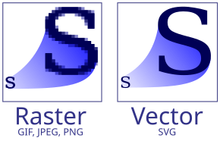
Vector Images
An alternative format
Image created from geometric shapes
  Points
  Lines
  Curves
  Polygons
Only need to store data for
  Points
  Lines/curves between them
  Smaller size than raster image
  Lossless compression
Easy to convert vector to raster

Slide 47

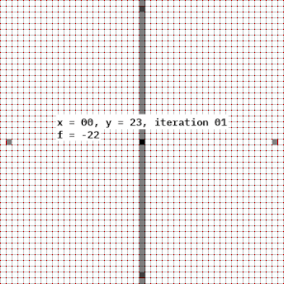
Rasterisation
Converting a vector graphic to a raster image
  Computes pixels that a line, curve, or shape will occupy in an image
For 2d images common algorithms are:
  Bresenham’s line algorithm
  Midpoint Circle algorithm

Slide 48
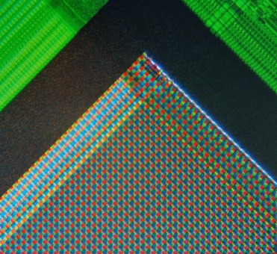
Image Capture
Digital Cameras and Scanners capture images from analogue sources(模拟源)
They do this by sampling(采样)
  Values are collected at discrete intervals(离散间隔）
They have grid of microsensors to sense received light
  Each microsensor generates a pixel
The number of samples is the resolution（分辨率）
  Expressed as pixels per inch (ppi)

Slide 49
Video/Animation
Video and animation is a series of still images
Each image is a frame
The number of frames per second (fps) defines how seamless the sequence seems
  The frequency of the eye is about 60 Hz, so under 60 fps may seem jerky
Depending on frame resolution and fps, this may require a lot of space to store
  We can mitigate by interpolation
  Takes two consecutive frames and calculates difference between them
  Generates new frame as “midpoint”
  Can reduce motion blur or jerky video

Slide 50
Exercise
Create a PBM file for the image opposite
8$×8$ grid of 1-bit pixels

Slide 51
Summary
Text Representations
Other non-numeric data & data structure representations
Image Representations

